Slide 2
Using Windows Runtime and SDK to build Metro style apps
John Lam
Principal Program Manager Lead
Microsoft Corporation

Slide 3

Beer
http://www.flickr.com/photos/kellbailey/1763951722/

Slide 4
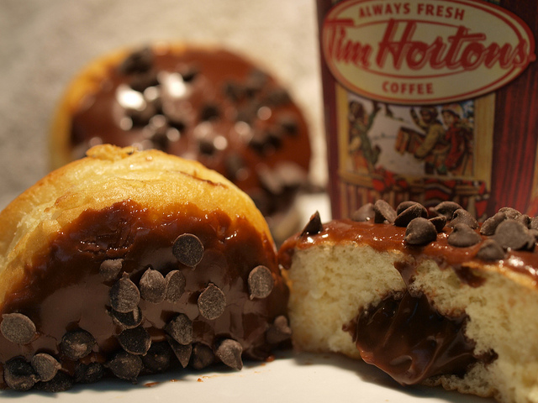
Donuts
http://www.flickr.com/photos/msvg/5200730922/

Slide 5

Coffee
http://www.flickr.com/photos/visualpanic/334916864/

Slide 6
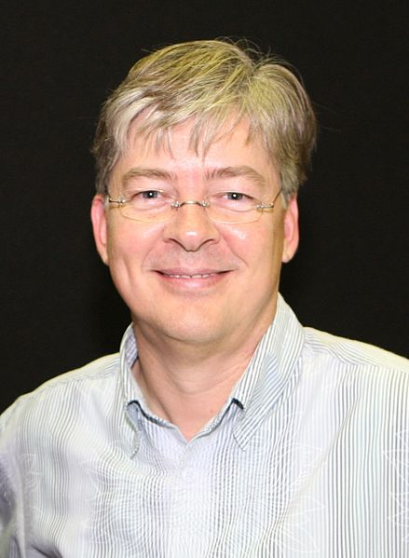
C#
http://en.wikipedia.org/wiki/File:Anders_Hejlsberg.jpg

Slide 7
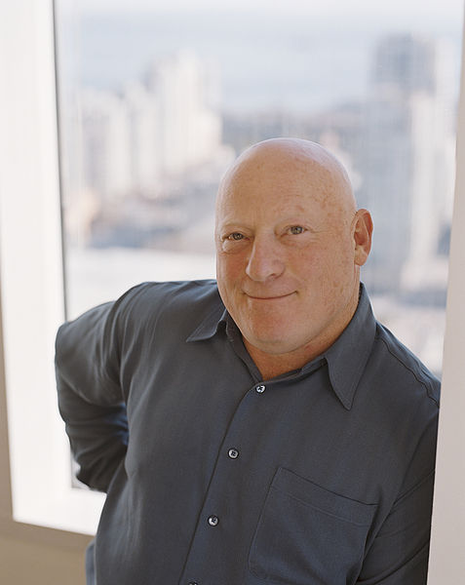
Visual Basic
http://en.wikipedia.org/wiki/File:AlanCooper.jpg

Slide 8
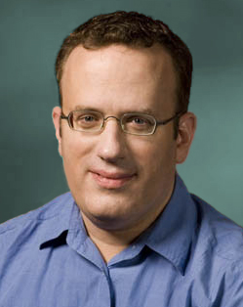
JavaScript
http://en.wikipedia.org/wiki/File:BEich.jpg

Slide 9
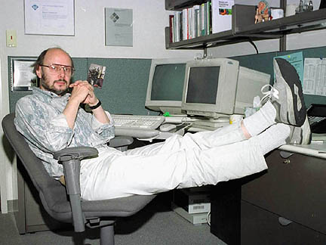
C++
http://en.wikipedia.org/wiki/File:BjarneStroustrup.jpg

Slide 10
Runtime Experience Team
JavaScript [EZE]
C#/VB & CLR
C++ & Windows SDK

Slide 11
No Programmer Left Behind

Slide 12
8 Things About Building Great Metro style apps
Use what you know
Use what you have
Light up on the OS
Mix and match your languages
When bad things happen
Use what others know
Getting it right
Ship it!

Slide 13
Let’s code!
demo

Slide 14
8 Things About Building Great Metro style apps
Use what you know
Use what you have
Light up on the OS
Mix and match your languages
When bad things happen
Use what others know
Getting it right
Ship it!

Slide 15



Related Content
Required Slide
*delete this box when your slide is finalized
Speakers, please list the Breakout Sessions, Labs, Demo Stations and Certification Exams that relate to your session. Also indicate when they can find you staffing in the TLC.
Breakout Sessions (session codes and titles)
Hands-on Labs (session codes and titles)
Product Demo Stations (demo station title and location)
Related Certification Exam
Find Me Later At…

Slide 16
Track Resources
Required Slide
*delete this box when your slide is finalized
Track PMs will supply the content for this slide, which will be inserted during the final scrub.
Resource 1
Resource 2
Resource 3
Resource 4

Slide 17



Resources
Learning
Connect. Share. Discuss.
Microsoft Certification & Training Resources
http://northamerica.msteched.com
www.microsoft.com/learning
TechNet
Resources for IT Professionals
Resources for Developers
http://microsoft.com/technet
http://microsoft.com/msdn

Slide 18
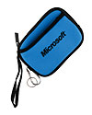

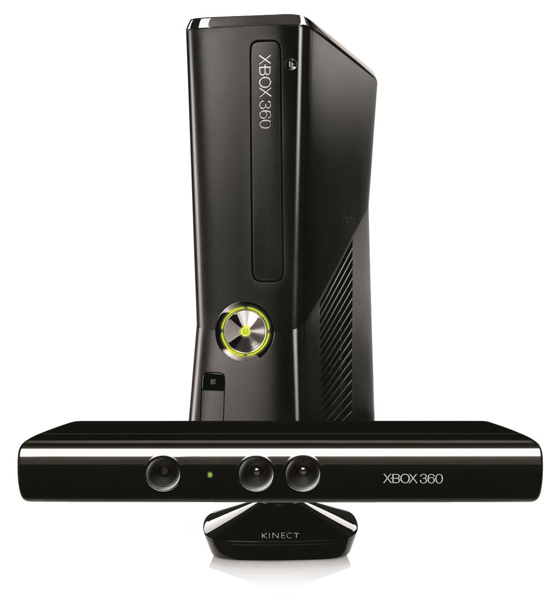




Required Slide
Complete an evaluation on CommNet and enter to win!

Slide 19

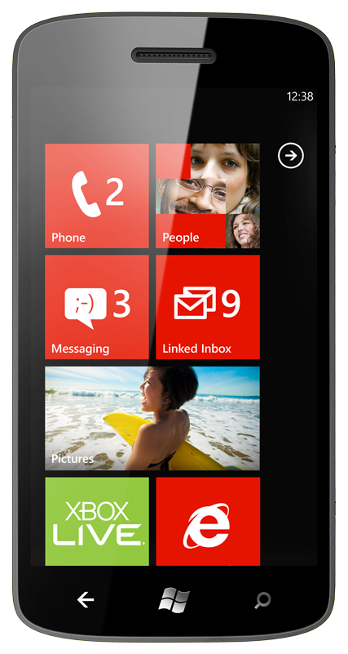
MS Tag
Required Slide
*delete this box when your slide is finalized
Your MS Tag will be inserted here during the final scrub.
Scan the Tag
to evaluate this
session now on
myTechEd Mobile
Notes:
TechEd is working with Microsoft Tag (http://tag.microsoft.com/overview.aspx) to create a unique Tag for every session at the event. Your session Tag will appear on both the room signage and at the end of your presentation. With your session Tag, attendees will be able to scan as they enter the room to retrieve session details, view speaker bios, and engage in discussions; or scan at the end of the presentation to evaluate your session and download materials.

Slide 20
© 2012 Microsoft Corporation. All rights reserved. Microsoft, Windows, Windows Vista and other product names are or may be registered trademarks and/or trademarks in the U.S. and/or other countries.
The information herein is for informational purposes only and represents the current view of Microsoft Corporation as of the date of this presentation. Because Microsoft must respond to changing market conditions, it should not be interpreted to be a commitment on the part of Microsoft, and Microsoft cannot guarantee the accuracy of any information provided after the date of this presentation. MICROSOFT MAKES NO WARRANTIES, EXPRESS, IMPLIED OR STATUTORY, AS TO THE INFORMATION IN THIS PRESENTATION.

